Slide 1

Hope Nottingham
A huge thank you from
Notes:
Today we want to say a huge thank you to you all for donating food to Hope Nottingham's food banks.
We're going to tell you a little bit about what food banks do, and where your donated food goes.

Slide 2
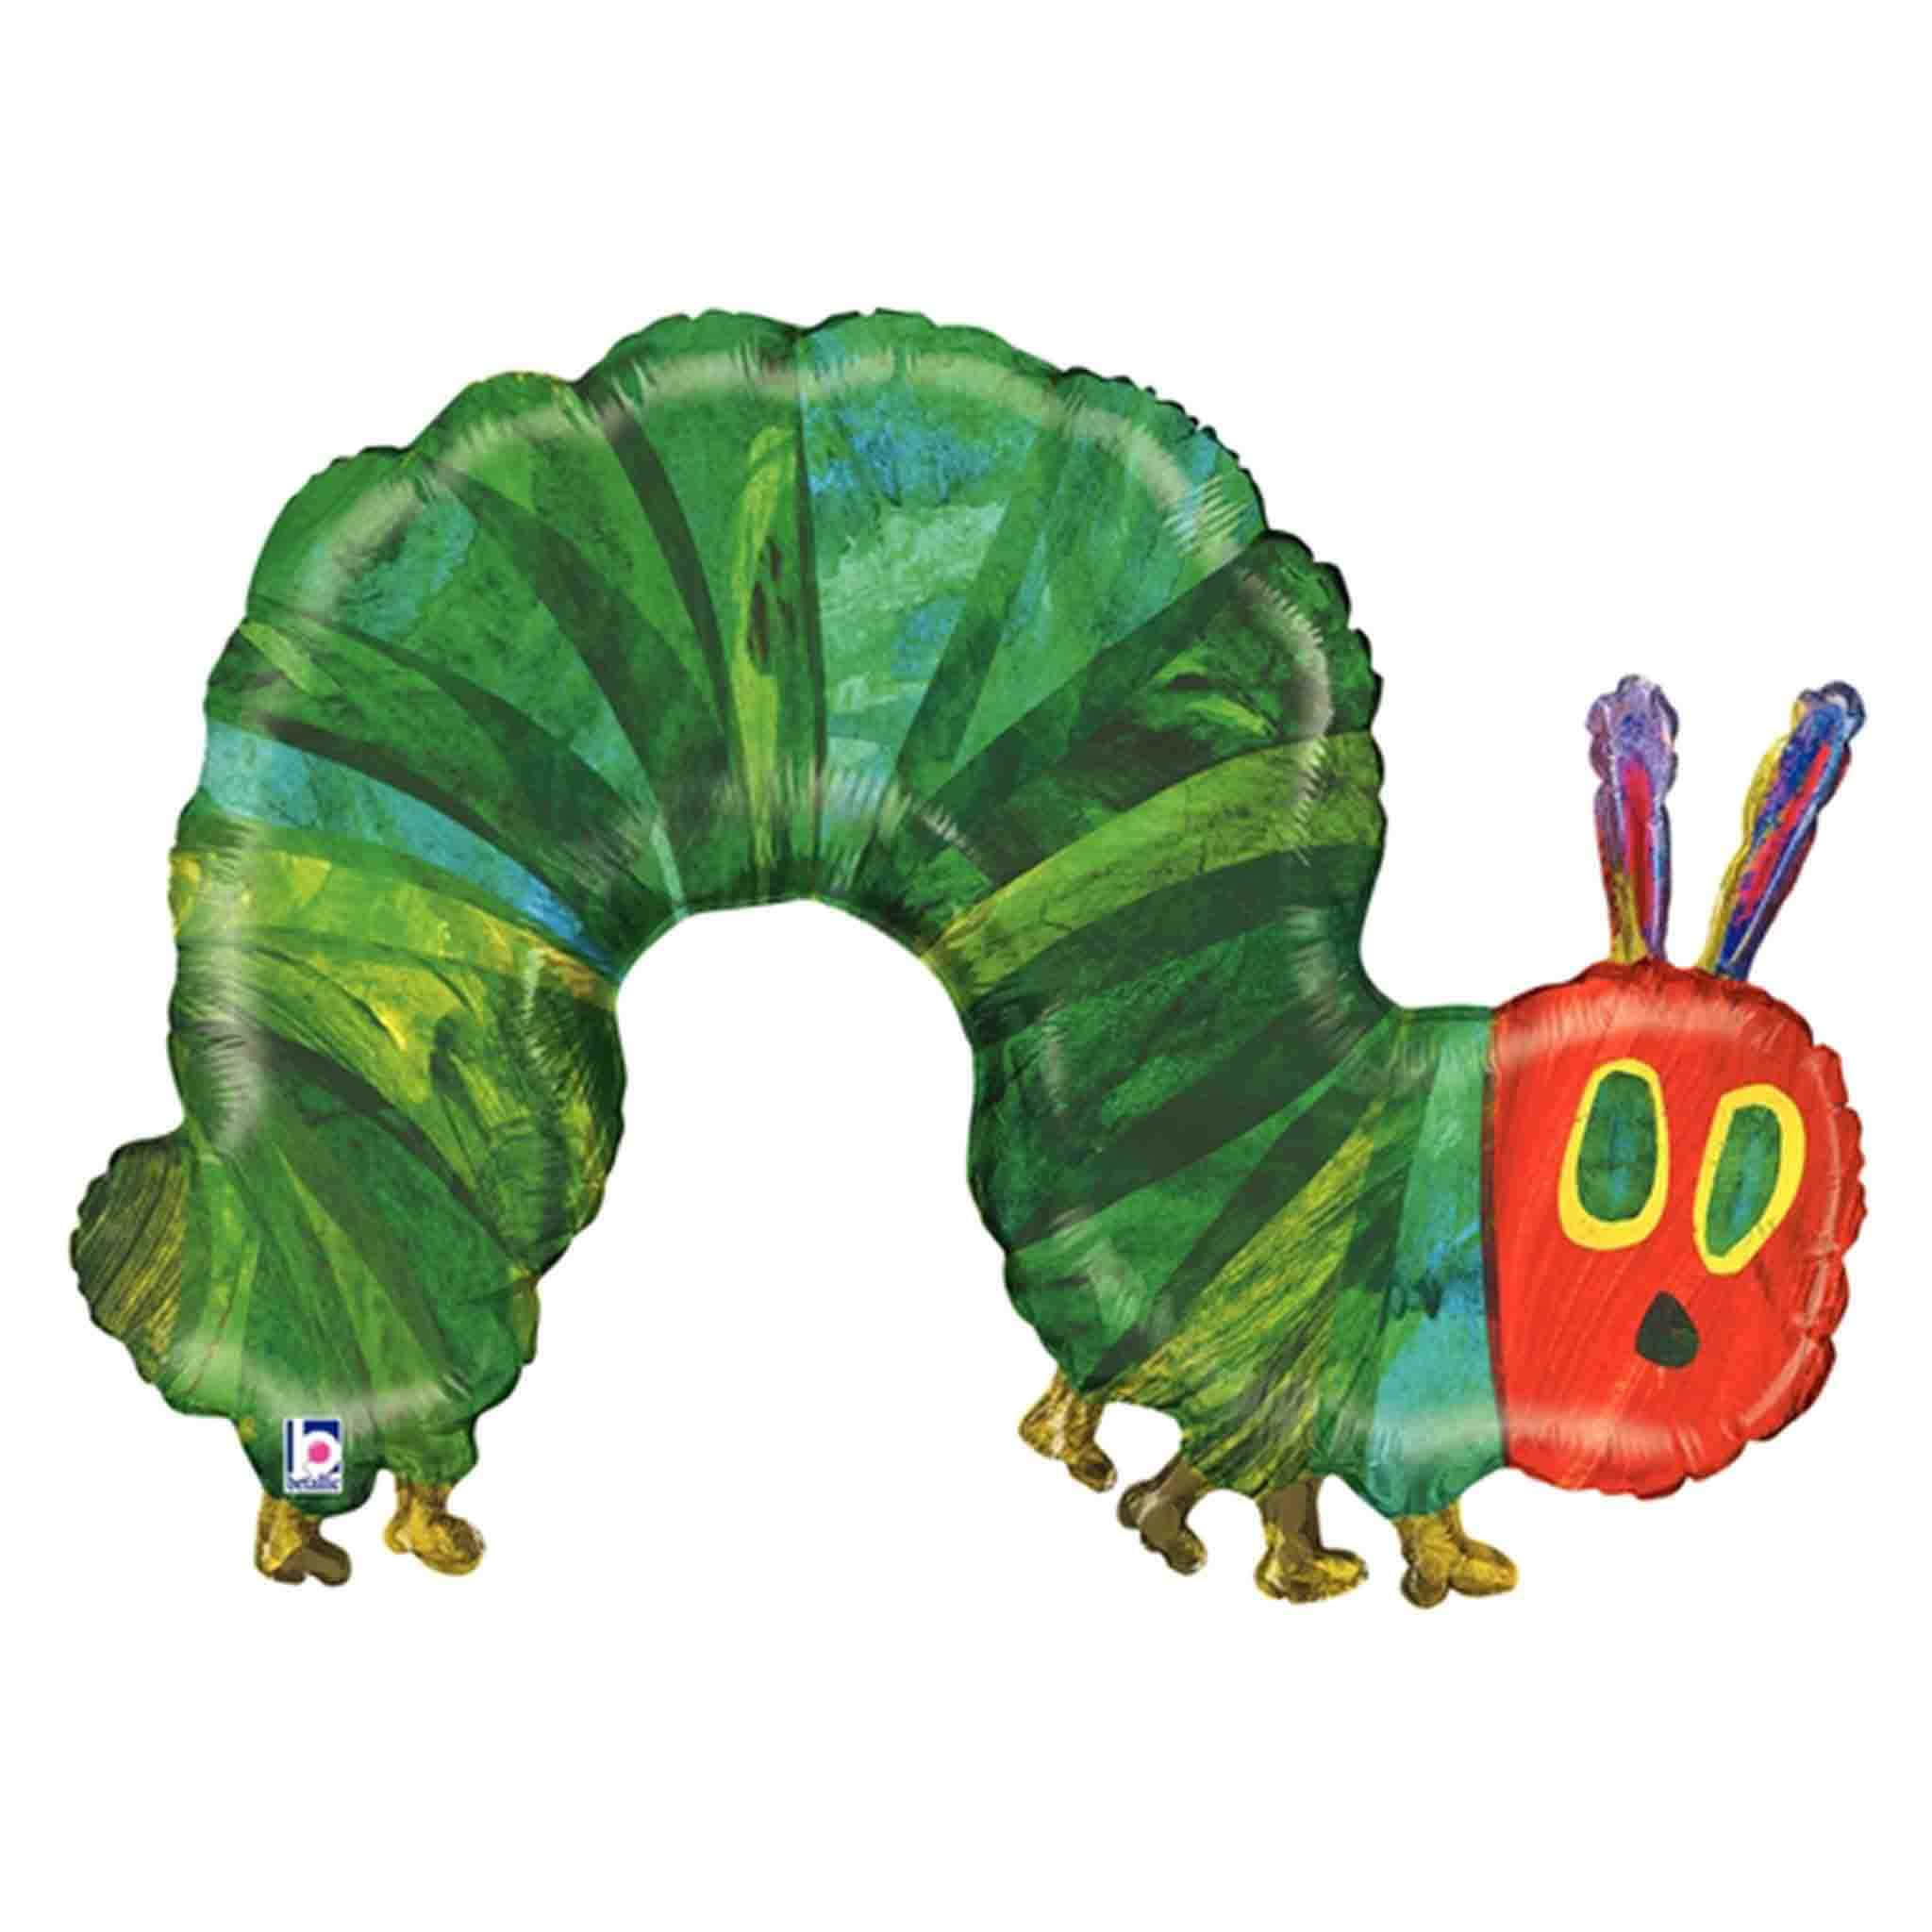
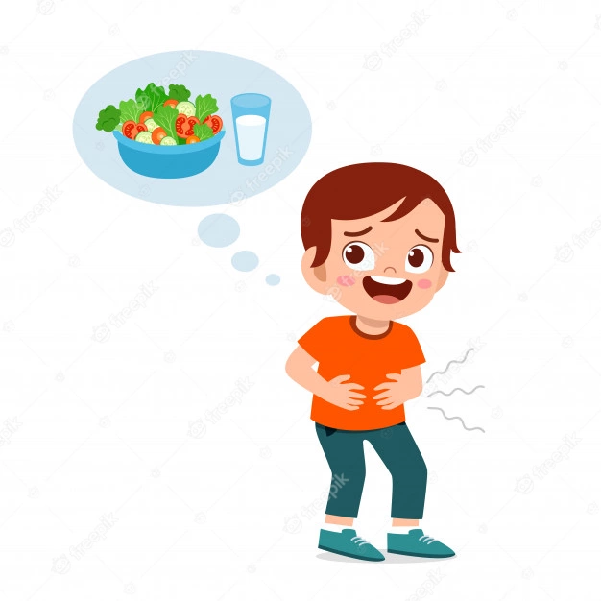
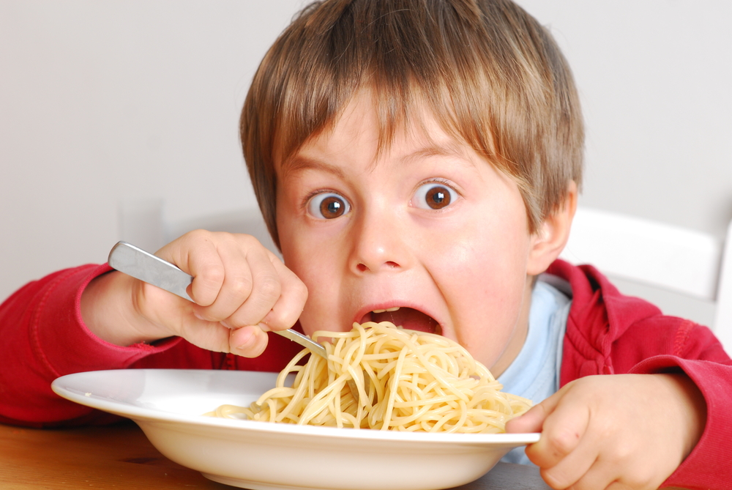
Have you ever felt hungry?
Notes:
Have you ever felt hungry?
What does it feel like? How does it affect you? (Grumpy? Unable to concentrate?)
Sadly, there a people in our communities who go hungry a lot. Some people may not have enough money to afford the food they need. This may mean they have to regularly miss meals or not spend money on other things they need, such as heating, so they can buy food instead.

Slide 3
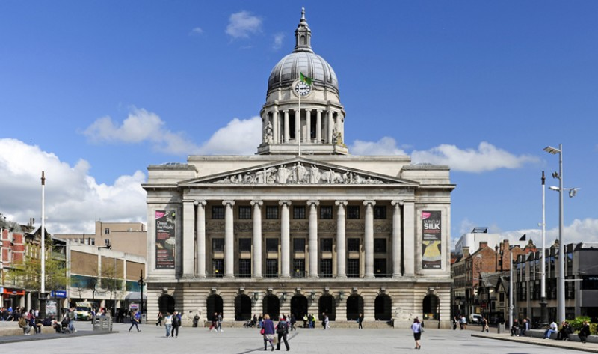
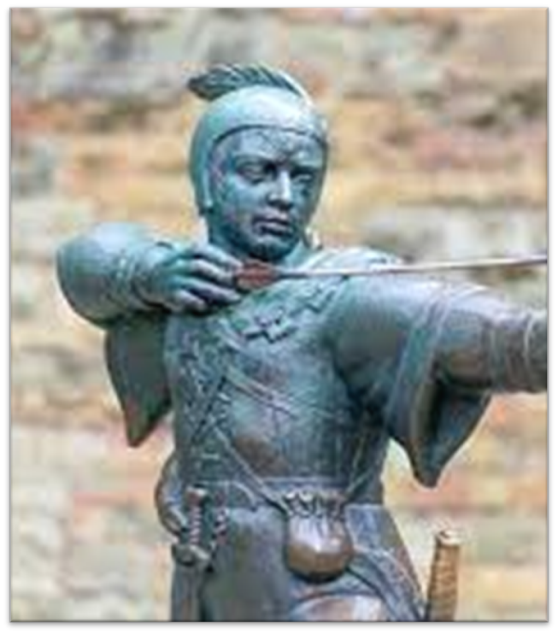


Hope Nottingham is a charity that runs food banks right across Nottingham.
But what is a food bank
and what do they do?
Notes:
Hope Nottingham is a charity that runs food banks across Nottingham. We have 14 food banks that serve local communities across the city.
These are located in Aspley, Beeston, Bilborough, Broxtowe, Carlton, Chilwell, Meadows, Netherfield, Radford Arboretum, Radford Bobber's Mill, Sneinton, Stapleford Haven, Stapleford Montrose Court, and Wollaton.
We are part of the Trussell Trust network which also supports other food banks in Nottingham and right across the UK.

Slide 4
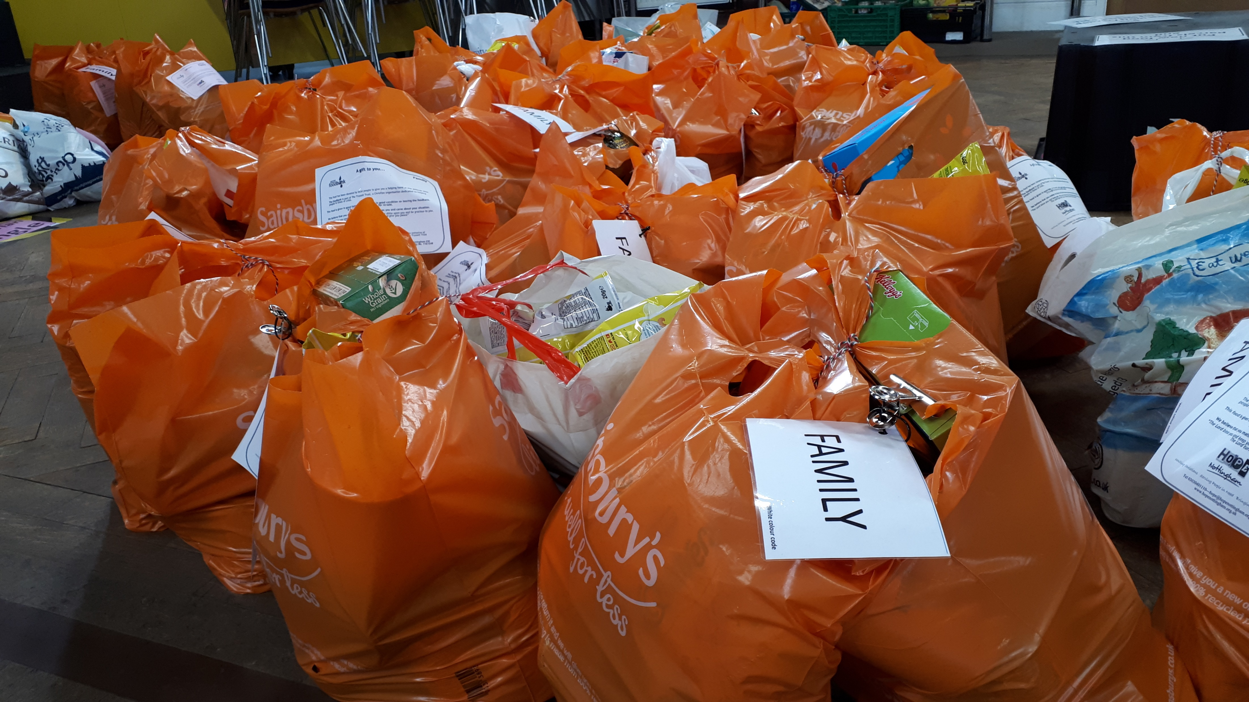
Our food banks are places where people who are struggling to afford food can come to get an emergency food parcel.
Notes:
Food banks provide an emergency food parcel to people who are struggling to afford food.

Slide 5

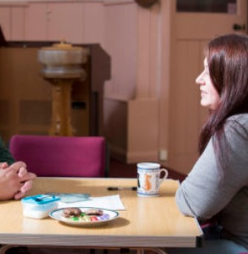
Our food banks are also places where people can share what they’re going through…
…and be directed to other support they might need.
Notes:
Our food banks also provide somewhere people can talk about what they're going through. Our volunteers will be able to signpost people to other help that is available such as advice services or local support groups.

Slide 6
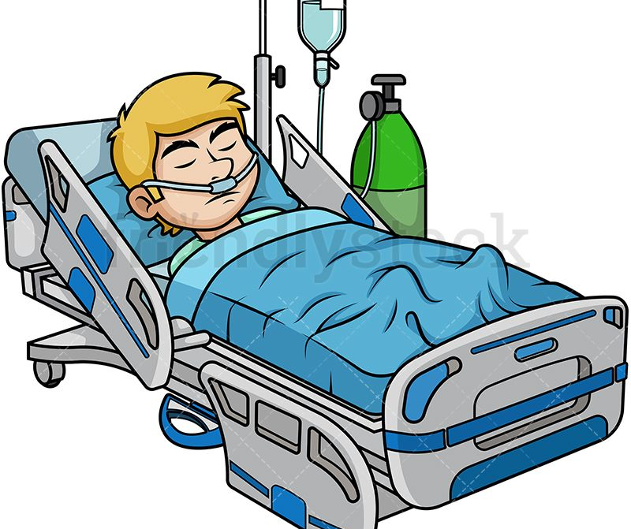


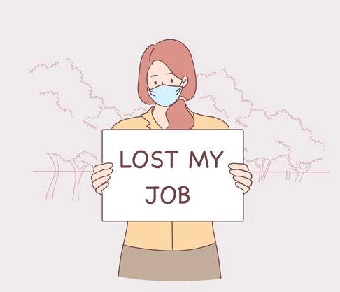
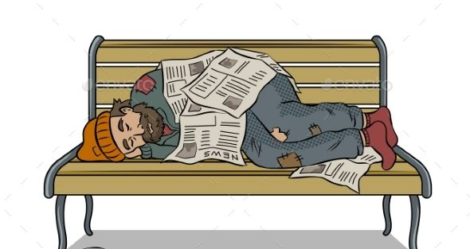
Why do people need help from food banks?
All sorts of people need our help for all sorts of reasons.
It can happen to anyone.
Notes:
People access food bank help for many reasons and we see people from all sorts of backgrounds and situations.
It may be that someone has lost their job or is unable to work due to illness or disability. It may be that someone can't afford to pay bills or is in debt. It may be that people are struggling with personal situations such as homelessness, addiction or mental health issues.
Every situation is different – but we welcome everyone who needs our help.

Slide 7
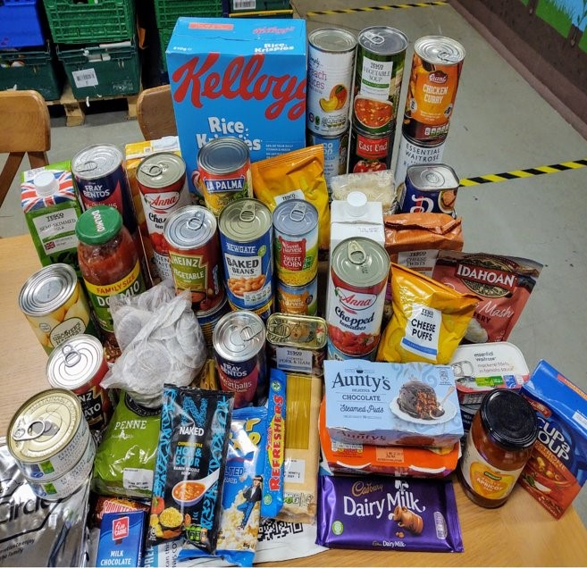

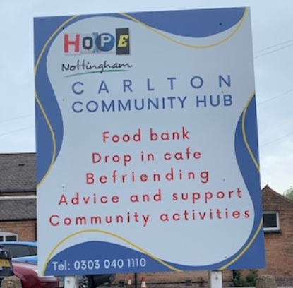
People are referred to our food banks by support workers or organisations who know about their situation…
…so they can come to the food bank to receive an emergency food parcel.
Notes:
People who need a food parcel are referred to the food bank by a support worker who knows about their situation and is helping them with what they are going through. People will get a food parcel to help them in the short term, and will be supported so their situation improves – hopefully meaning they will be less likely to need food parcels in the future.

Slide 8





All the food we give to people is kindly donated to us.
Notes:
Hope Nottingham is a charity. We are only able to give out emergency food parcels thanks to local people generously donating to us.
Most of out donations come from people putting food in donation points in their local supermarket; collections from local churches; collections and donations from local schools; local businesses and community groups; and individual local people.

Slide 9
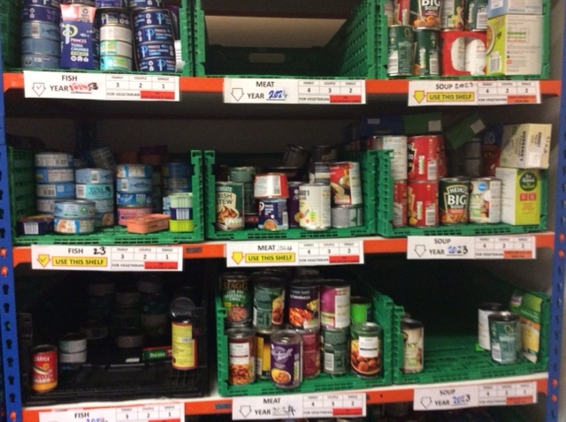
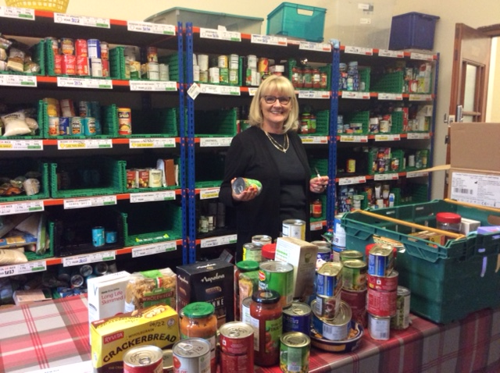
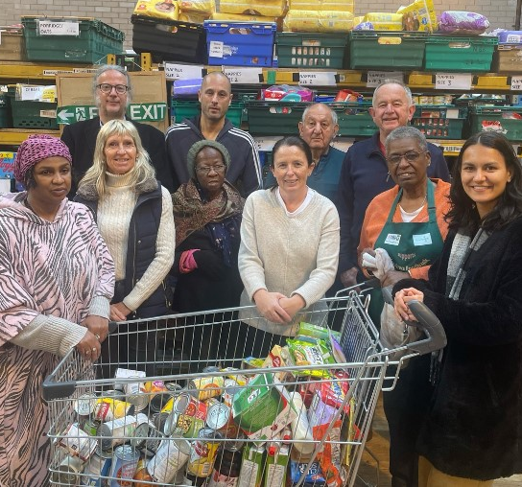
It is then sorted, dated and packed into parcels by our amazing volunteers…
…ready to be given to
people who need it.
Notes:
The food that you and others donate is weighed, sorted, dated and packed into food parcels by volunteers at each of our 14 food banks, ready to give to people who need it. Each parcel is packed according to the number of people in the household. We do our best to cater for different dietary requirements.

Slide 10
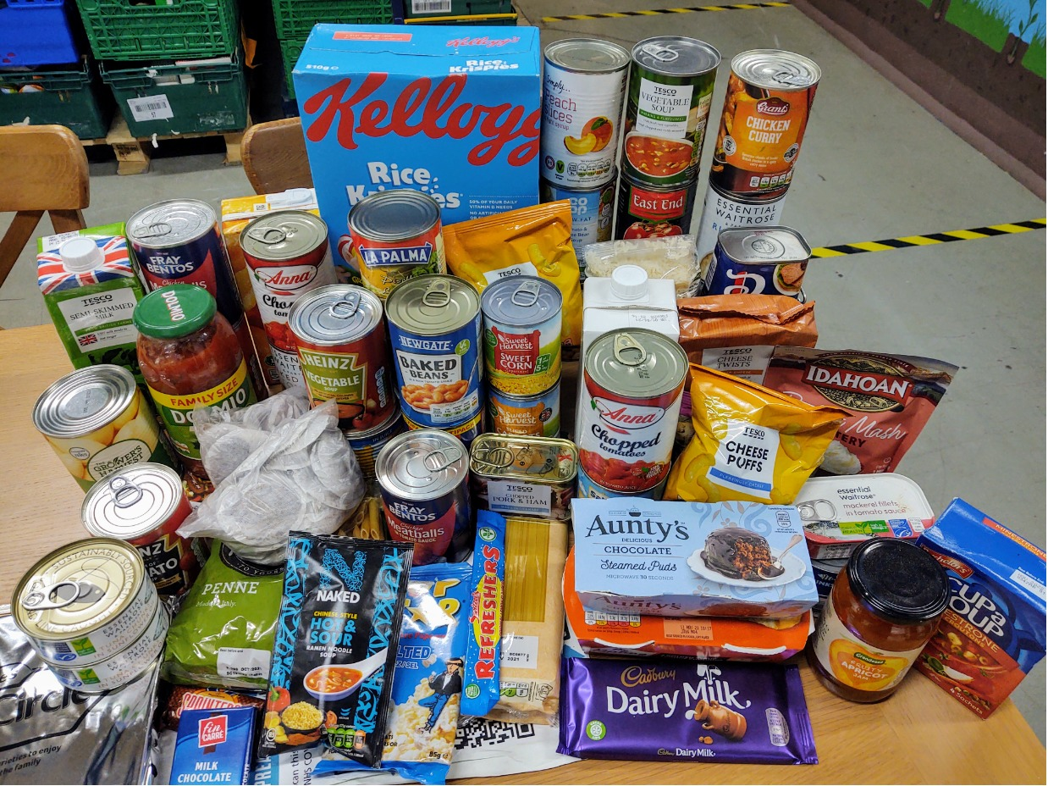
So what goes into a food parcel?
Enough food to last a person or family 3 days!
What sort of items do you eat over 3 days?
Notes:
Our emergency food parcels provide enough food to provide nutritionally balanced meals for 3 days (for the number of people in the household). However, we are only able to give ambient food (tins and packets), not fresh or frozen foods.
Our parcels generally contain:
Tinned soup
Tinned meat (e.g. corned beef, ham, stewed steak, curry, chilli, meatballs etc)
Tinned fish
Tinned potatoes or instant mash
Tinned vegetables
Tinned baked beans and/or spaghetti
Pasta and/or rice
Jars of pasta sauce and/or tinned tomatoes
Tinned fruit
Custard and/or rice pudding
Biscuits
Jam
Breakfast cereal/porridge
Tea or coffee
Juice or squash
Snacks (e.g. chocolate/crisps/cereal bars)
We are also sometimes able to provide toiletries such as shampoo, shower gel, soap, toothpaste and sanitary towels.

Slide 11
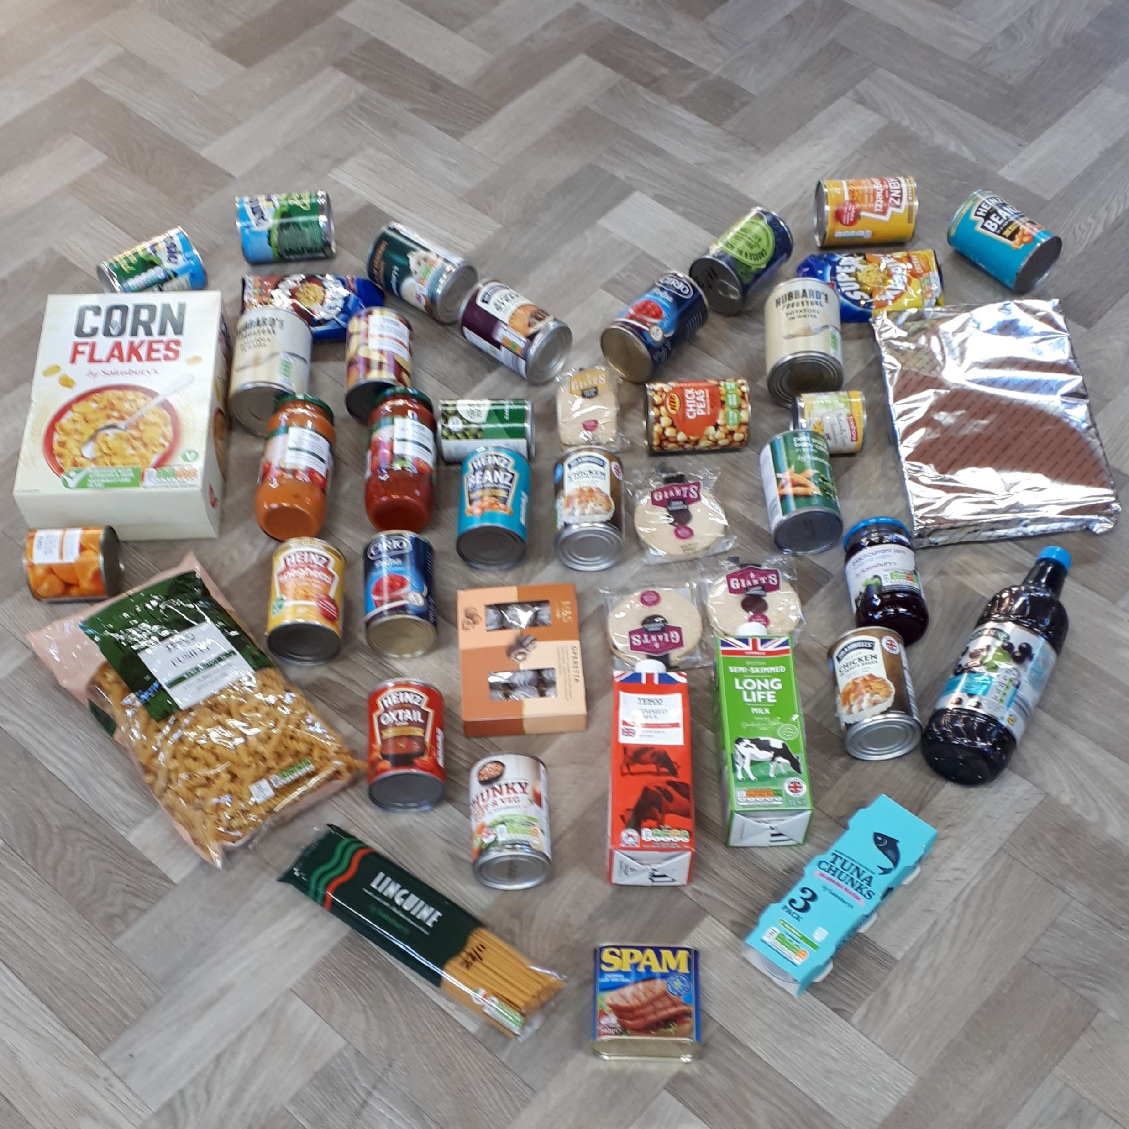
How else can I help people?
Sometimes we might not be able to donate things, but we can all still help look after people!
Being kind to other people
Doing something nice for someone
Helping people when they’re struggling with something
Notes:
Hope Nottingham's vision is to "Inspire and grow communities of Hope".
Giving hope to people is something we can all do – whether we are in a position where we are able to donate or not.
Kindness, showing we care, looking out for others and helping people all helps bring hope to those who need it.
Thank you for being part of growing communities of Hope across Nottingham!

Slide 12
Thank you for all your support and donations.
Notes:
We want to say another huge thank you to everyone for the donations you have given. Whether it is a box load or just one tin, every donation makes a real difference – and we wouldn't be to help people without your support. Thank you.

